Slide 1
Konsep dan Jenis Teknologi Informasi
INTRODUCTION TO INFORMATION TECHNOLOGY
Nafisatul Hasanah, S.Kom., M.M.
FAKULTAS ILMU KOMPUTER
PROGRAM SARJANA TEKNOLOGI INFORMASI

Slide 2
Capaian Pembelajaran
Komponen TI
Keuntungan dan kekurangan penggunaan TI
Aplikasi TI

Slide 3
Pendahuluan
Komponen Penilaian:
Kehadiran/Keaktifan
Quiz/Tugas
UTS
UAS
VIDEO (LINK)

Slide 4
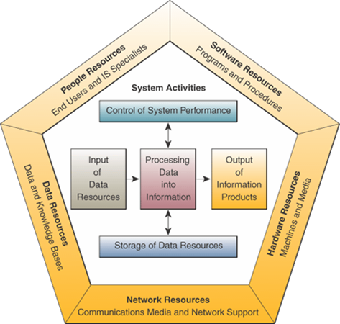
Komponen TI

Slide 5
Komponen TI

Slide 6
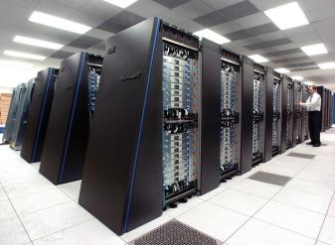
Kategori Komputer
SUPER COMPUTER
SIZE : occupy a full room of equipment
SPEED : tens of thousands of processors
STORAGE : extremely large (3.1 PB)

Slide 7
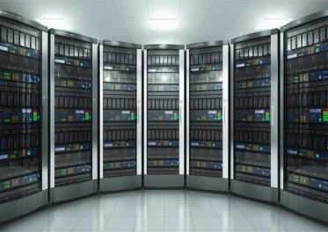
Kategori Komputer
MAIN FRAME
SIZE : occupy partial room to a full room of
equipment
SPEED : dozens of processors
STORAGE : very large & addable storage
(4.6 TB)

Slide 8
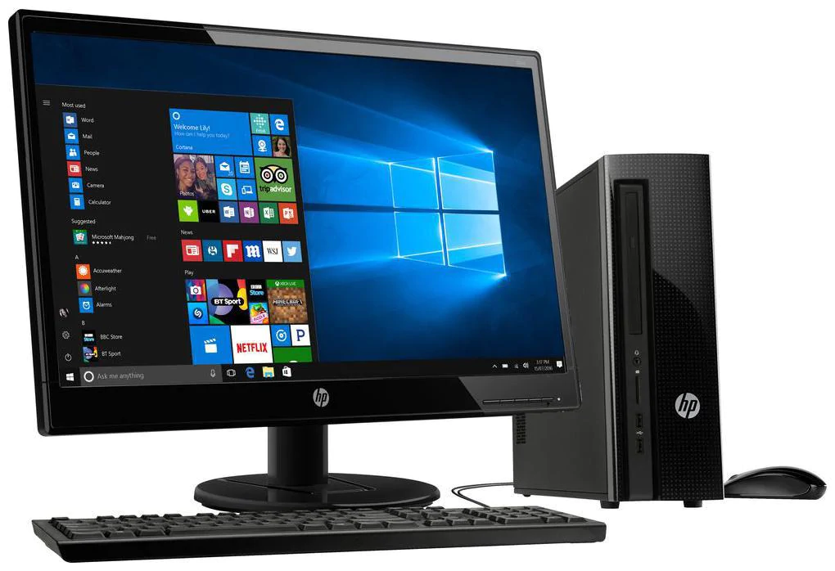
Kategori Komputer
PERSONAL COMPUTER
SIZE : fits on a desk
SPEED : single processor
STORAGE : large (500GB)

Slide 9
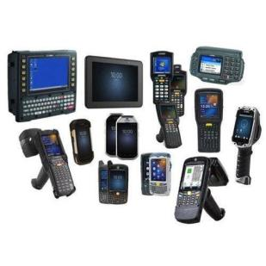
Kategori Komputer
MOBILE COMPUTER
SIZE : fits on your lap or in your hand

Slide 10
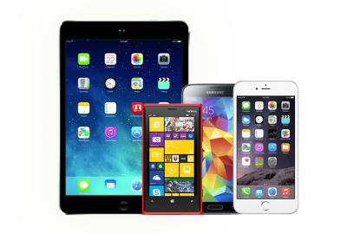
Kategori Komputer
MOBILE DEVICE
SIZE : fits in the palm of your hand or
a pocket size

Slide 11
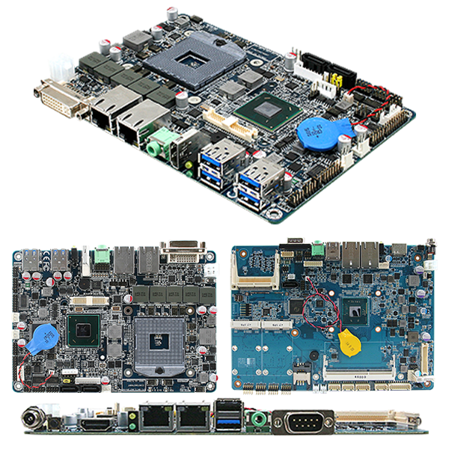
Kategori Komputer
EMBEDDED COMPUTER
SIZE : miniature. it is mounted on a
circuit board and then installed in a machine or appliance using wires to carry input
and output signals

Slide 12





Keuntungan Penggunaan TI
SPEED
COMMUNICATION
RELIABILITY
CONSISTENCY
STORAGE

Slide 13





Kelemahan Penggunaan TI
VIOLATION OF PRIVACY
PUBLIC SAFTY
IMPACT OF LABOUR FORCE
HEALTH RISK
IMPACT ON ENVIRONMENT

Slide 14




Aplikasi TI
SCIENCE
EDUCATION
FINANCE
GOVERNMENT

Slide 15

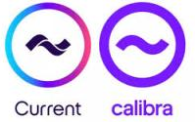
Aplikasi TI
EDUCATION
LEARNING MANAGEMENT SYSTEM
COMPUTER BASED TRAINING
E-LEARNING
LIBRARY LOAN SYSTEM
E-TEST
FINANCE
ONLINE BANKING SYSTEM
ELECTRONIC PAYMENT SYTEM
FINANCE INVESTMENT SYSTEM

Slide 16


Aplikasi TI
GOVERNMENT
E-FILING
E-PENYATA GAJI & LAPORAN
HRMIS
UPU ONLINE
E-SYARIAH
HEALTH CARE
MEDLINE
COUNTER REGISTRATION SYSTEM
TELEMEDICINE

Slide 17


Aplikasi TI
SCIENCE
VIRTUAL REALITY
COCHLEAR IMPLANT
HAWK EYE OFFICIATING SYSTEM
NEURAL NETWORK
PUBLISHING
ONLINE NEWSPAPER & ONLINE MAGAZINE
ONLINE PHOTO PRINTING
ONLINE CARD PRINTING

Slide 18


Aplikasi TI
TRAVEL
GLOBAL POSITIONING SYSTEM (GPS)
ONLINE RESERVATION SYSTEM
E-TICKETING SYSTEM
MANUFACTURING
COMPUTER-AIDED DESIGN
COMPUTER-AIDED MANUFACTURING

Slide 19
Ringkasan

